Slide 1
Next Up:
Emrys MacInally

Slide 2
3
3

Slide 3
2

Slide 4
1

Slide 5
The art of throwing errors
Emrys MacInally

Slide 6

Many thanks to our sponsors:

Slide 7



Emrys MacInally
Team Lead Deployment & Automation @ medavis
Working in IT for 19 years
Fell in with PowerShell 15 years ago

Slide 8
Contents
What are errors
Types of errors
Error Record
Ways to throw errors

Slide 9
What this talk is...
...about
throwing errors
...not about
error handling (we might touch this topic)

Slide 10
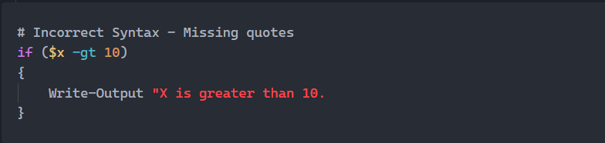
What are Errors?
Syntax Errors
Code that breaks the grammatical rules of the language

Slide 11

What are Errors?
Logical Errors
Flaws in program logic leading to incorrect results despite successful execution.

Slide 12
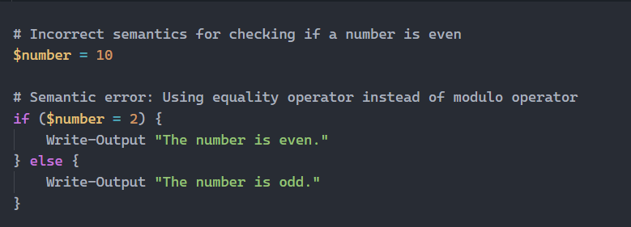
What are Errors?
Semantic Errors
Correct syntax but incorrect meaning or use of operations; the program runs but performs unintended actions.

Slide 13
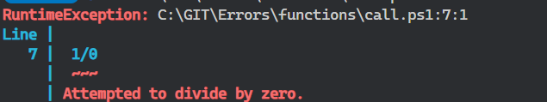
What are Errors?
Runtime Errors (Focus of Presentation):
Errors that occur during program execution, such as division by zero or accessing invalid memory.

Slide 14
Types of errors
Non-terminating errors
Do not stop the execution of the script.
Examples:
Write-Error
$PSCmdlet.WriteError()

Slide 15
Types of errors
Terminating errors
Stops the execution of the script or command unless they are caught within a try/catch block
Examples:
Throw
$PSCmdlet.ThrowTerminatingError()

Slide 16
Demos
We love Demos!

Slide 17
Conclusion
Give users as much information as possible!
Use terminating errors as default
Use non-terminating errors if processing items in a loop or pipeline
Use $PSCmdlet.WriteError() and $PSCmdlet.ThrowTerminatingError() if possible
Use throw with an ErrorRecord
Always use try/catch

Slide 18
Q&A
15 minutes

